Slide 1

How to thrive in a post Zombie-Apocalyptic world
U of O Data Analytics Bootcamp
November 2020
Danica Tiegs, Lauren Gardner,
Siara Leninger, Stacey Wai

Slide 2
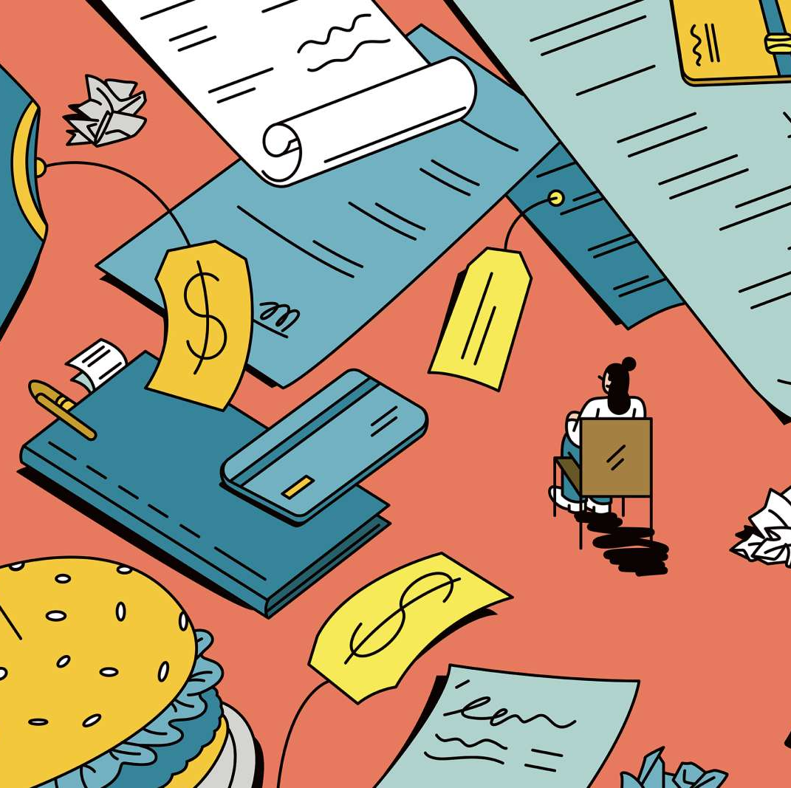
What items are necessary for survival?
Hypothesis: When the world is faced with fear and panic, certain items will unexpectedly become household necessities
How does spending correlate to a pandemic?
Expected trends v unexpected trends
Does spending change after a ”new normal” is established?
If we are faced with a second Apocalypse, what items should I have on hand?
Notes:
Stacey:
Hypothesis -

Slide 3
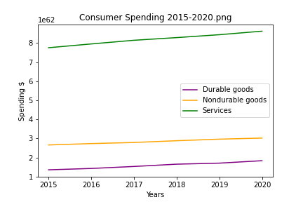
How we spent our money the past 5 years..
Data sourced from BEA (US Bureau of Economic Analysis) official PCE report
Notes:
Danica & Stacey
Danica – how we chose the data and cleansed data
Stacey:
Hypothesis -
Over the past 5 years we saw categories grew at ave rate of :
Durable goods: 6.24%
Nondurable: 2.58%
Services: 2.14%

Slide 4
Spending in the midst of panic and fear…

Slide 5
Durable Goods
Prescription & non-prescription drugs
Cleaning supplies
Notes:
Danica

Slide 6
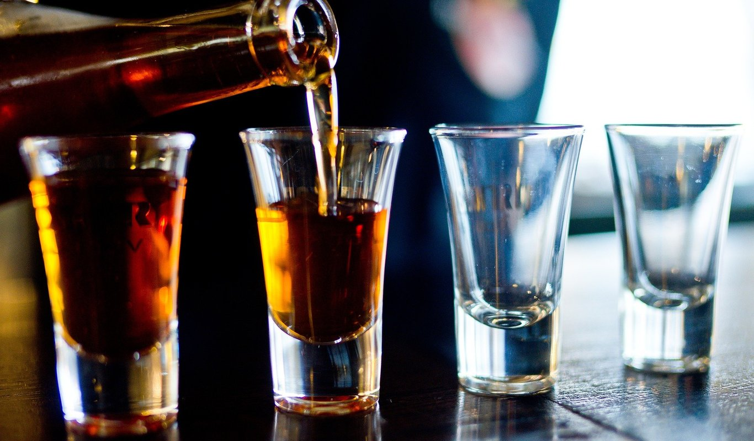
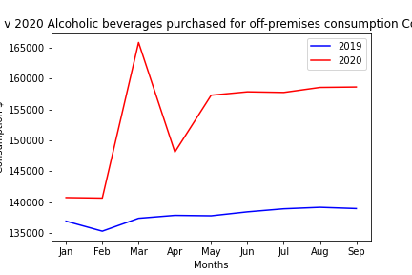
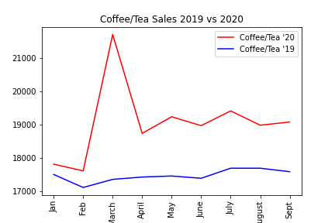
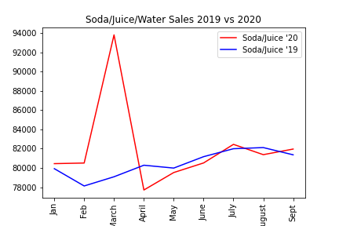
When in panic…always drink more
Notes:
Lauren & Stacey

Slide 7
Adjusting to a new normal…

Slide 8
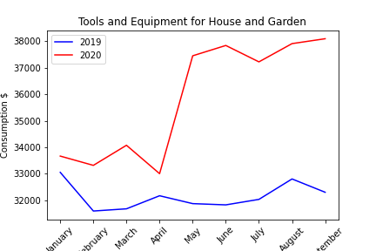
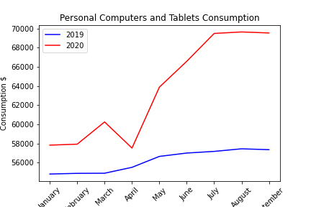
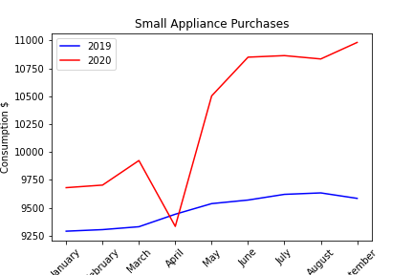
Being productive in a new world
Notes:
Siara

Slide 9
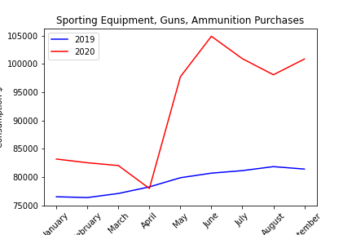
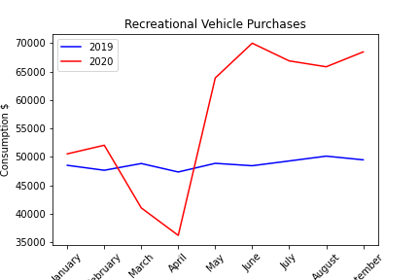
New ways to socialize
Notes:
Siara
Not part of the initial spike but items we saw an increase in post new-normal
recreational vehicles
Small appliance
Sporting eq, guns and ammunition
Gardening
Personal computers

Slide 10
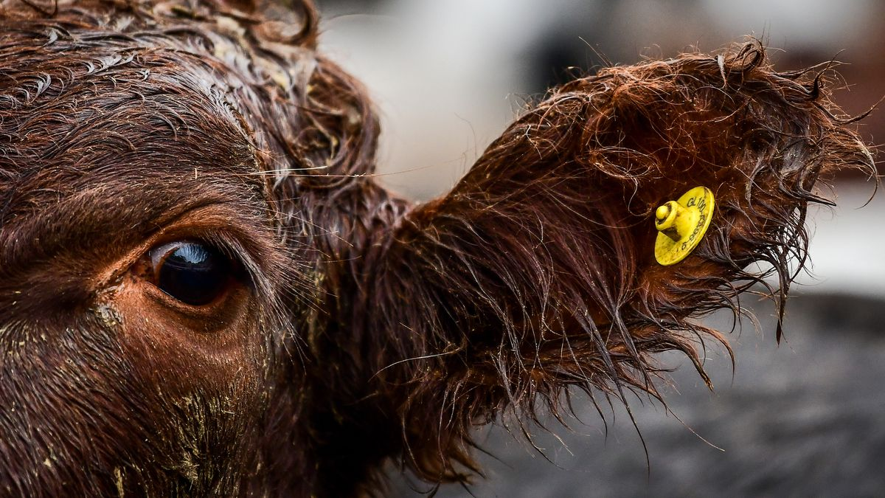
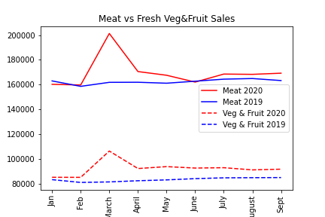
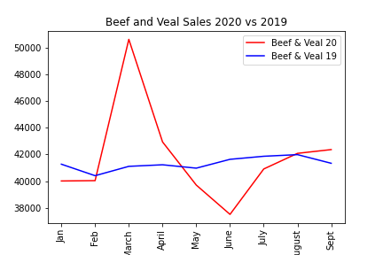
Meat Trends

Slide 11
Challenges Faced
Data cleansing the data output from BEA, created smaller subsets within Excel first then imported to Pandas
Large dataset with vague category descriptions making it difficult to understand data and find trends
Narrowing scope
Tieing our findings together cohesively

Slide 12
Final recommendation/conclusion
Notes:
Siara & Lauren

